Slide 1
Applications of Information & Communication Technology
Mr. Ali Haider
Institute Of Management Sciences

Slide 2
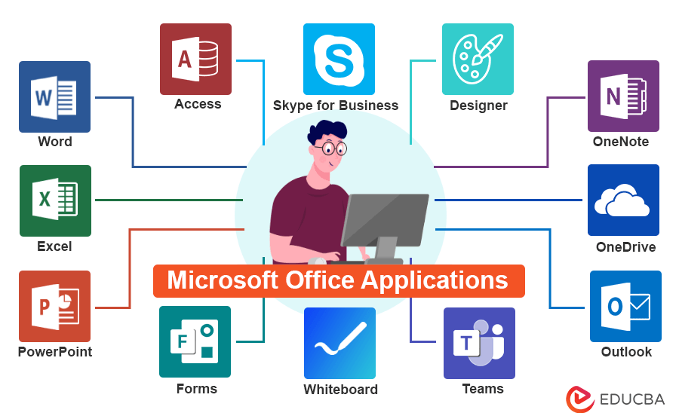
Microsoft Office

Slide 3
Microsoft Word
Typing Text: Simply click in the document area and start typing. You can enter text in any part of the document.
Editing Text: Select the text you want to change by clicking and dragging. Use the Backspace key to delete characters to the left of the cursor, or the Delete key to remove characters to the right.

Slide 4
Font Formatting
Font Style: Choose from a variety of fonts (e.g., Arial, Times New Roman) to set the tone of your document. The font can affect readability and aesthetics.
Font Size: Adjust the size of your text to make it larger or smaller (e.g., 12pt for standard text, 14pt for headings).
Font Color: Change the color of your text to highlight important sections or to fit a specific theme.

Slide 5
Paragraph Formatting
Alignment: Control how text is aligned within a paragraph:
Left: Aligns text to the left margin.
Center: Centers text between the margins.
Right: Aligns text to the right margin.
Justify: Aligns text evenly between both margins.
Line Spacing: Adjusts the amount of space between lines of text. Common settings are single spacing (1.0), one and a half spacing (1.5), and double spacing (2.0).
Indentation: Modify how far the text is indented from the left or right margin. The first line indent can be set differently from the rest of the paragraph for a clean look.

Slide 6
Using the Clipboard
Copy (Ctrl + C): Duplicates selected text, allowing you to paste it elsewhere.
Cut (Ctrl + X): Removes selected text and stores it in the clipboard for pasting.
Paste (Ctrl + V): Inserts the copied or cut text at the cursor’s location.

Slide 7
Document Formatting
Page Setup
Margins: Adjust the space around the document’s text. Standard settings include 1-inch margins on all sides.
Orientation: Choose between Portrait (vertical) and Landscape (horizontal) layouts depending on the content type.
Size: Select the document size, commonly A4 or Letter, to fit your needs.

Slide 8
Adding Page Numbers and Headers/Footers
Page Numbers: Automatically add page numbers to your document for easy reference. This can be done through the Insert tab.
Headers/Footers: Insert text that appears at the top (header) or bottom (footer) of each page, such as document titles, dates, or author names, for consistent information across pages.

Slide 9
Creating and Applying Styles
What are Styles? Styles are pre-defined formatting options that allow you to quickly apply a set of formatting choices to text, making it uniform and organized.
Heading Styles: Use heading styles (e.g., Heading 1, Heading 2) to create a structured outline in your document. This helps with navigation and organization.
Applying Styles: Access the Styles pane from the Home tab to easily apply and modify styles across your document, ensuring a cohesive look.

Slide 10
Thank You.
The End

